Slide 1
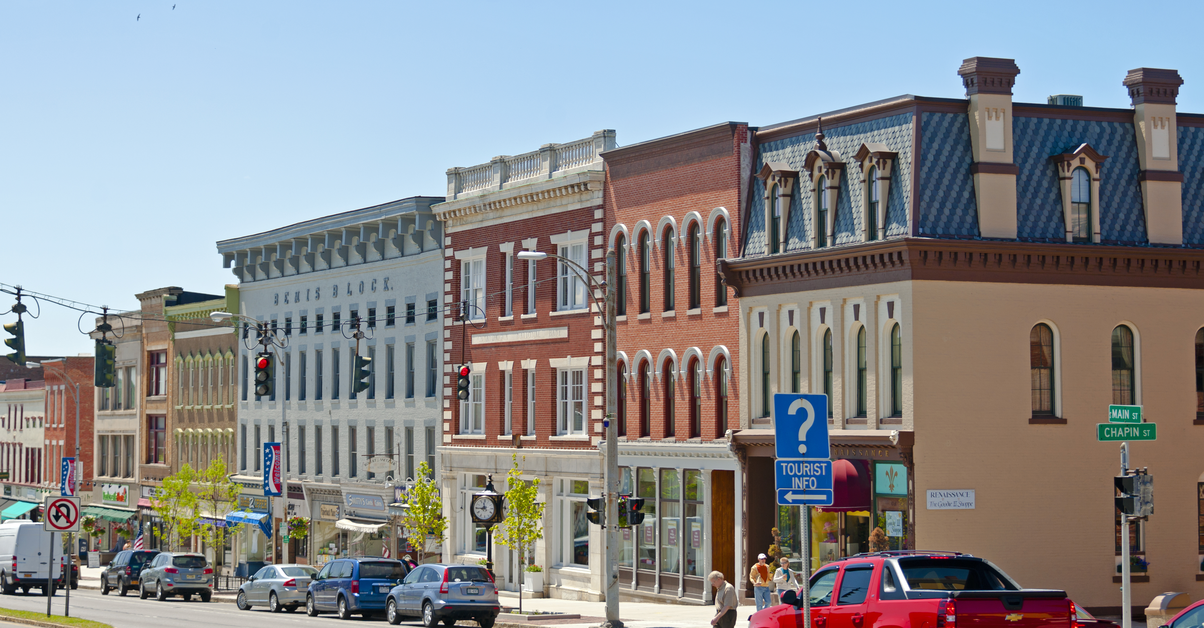


STATE OF THE HEARTLAND
Preliminary findings
May 7, 2018

Slide 2

1
What we’re doing
2
Initial indicators
Strengths
Weaknesses
Key measures

Slide 3


Slide 4
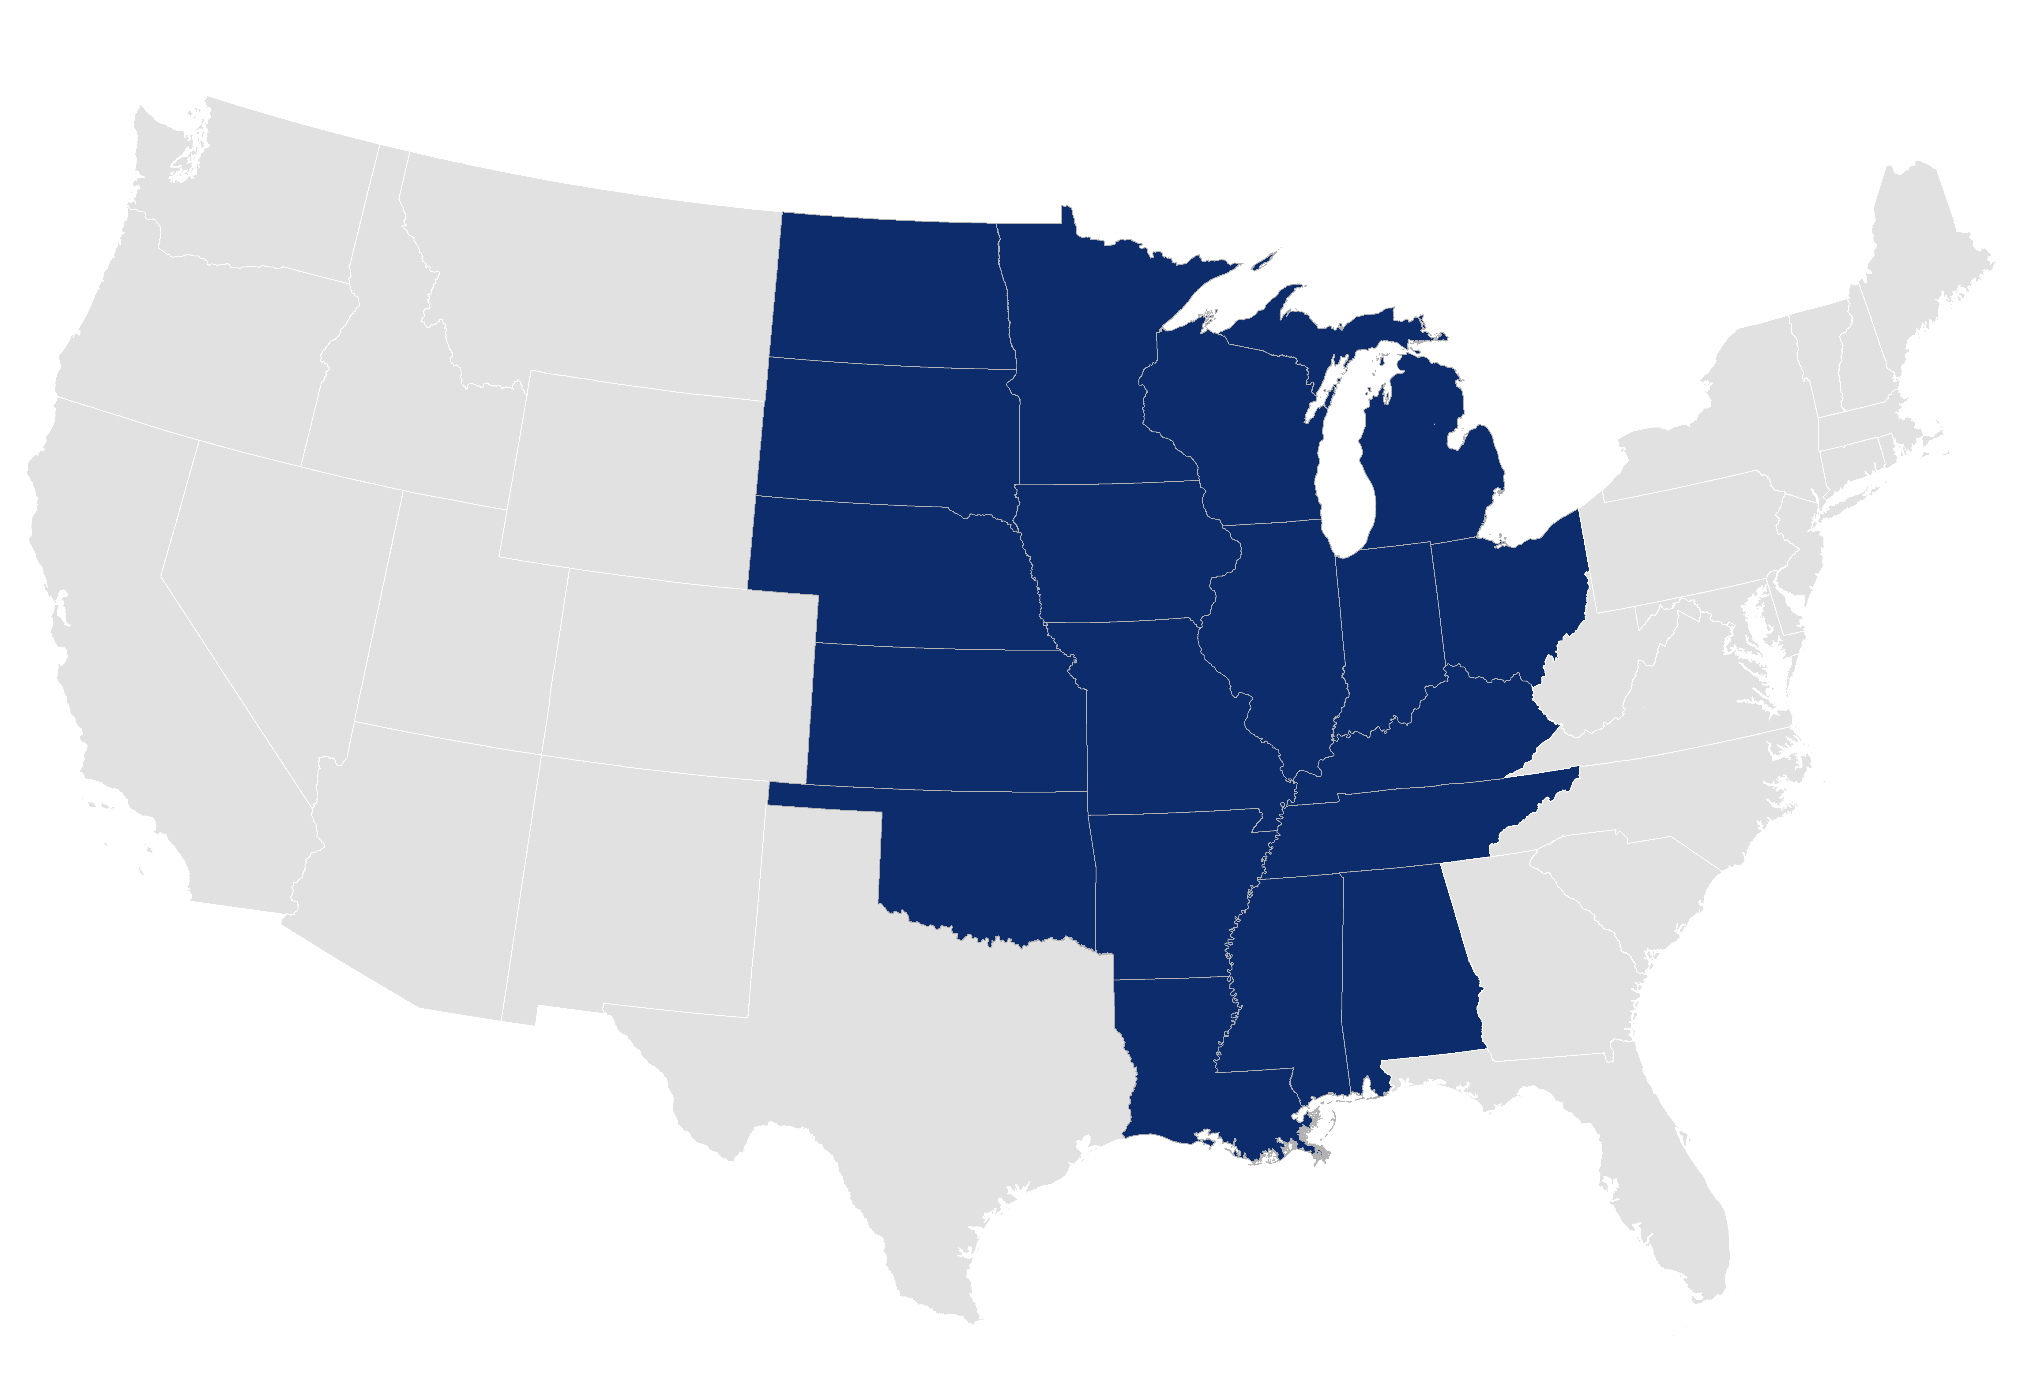
The Heartland is a 19-state “country within the country”

Slide 5
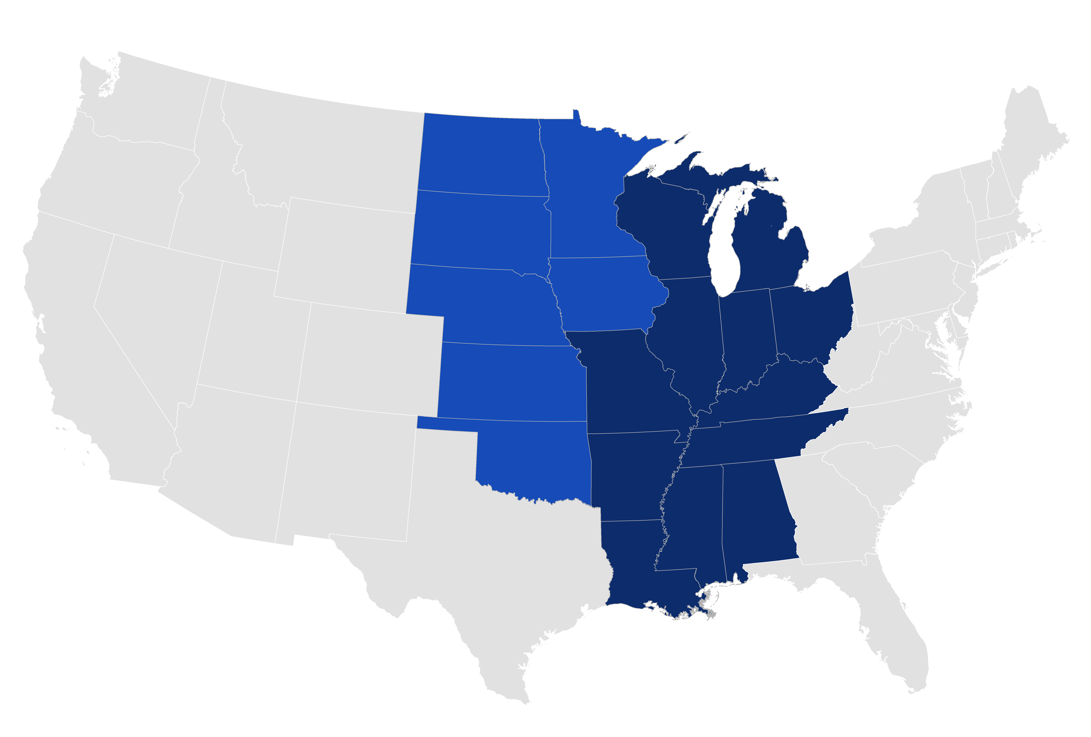
Sub-regions to the east and west comprise distinct experiences within the region

Slide 6
We are seeking to inform a robust debate about the Heartland’s untapped potential and its persistent challenges

Slide 7
1
What we’re doing
2
Initial indicators
Strengths
Weaknesses
Key measures

Slide 8
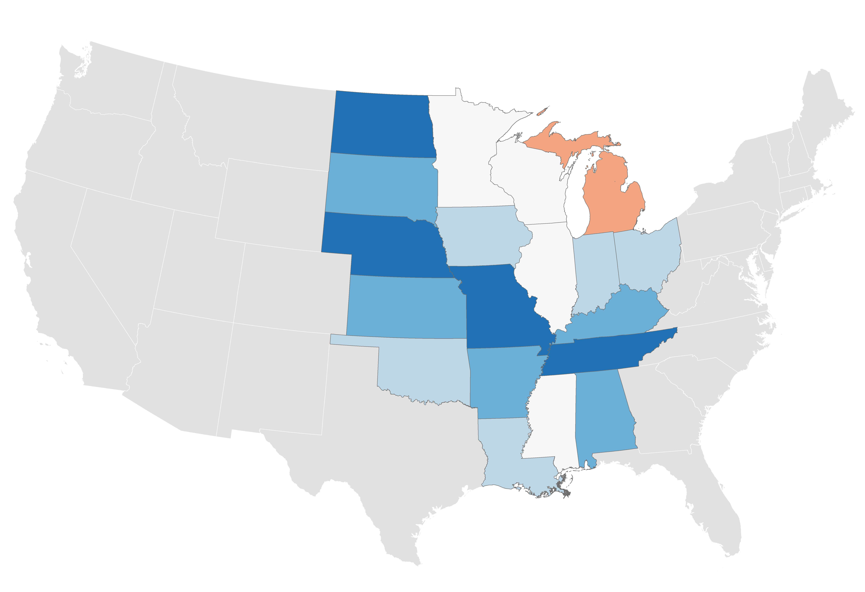
Wage growth in many states has been strong in recent years
Fastest:
North Dakota (1.68%)
Slowest:
Michigan (-0.02%)
Real median hourly wages CAGR
2010 – 2017
-0.02% — 0.00%
0.00% — 0.25%
0.25% — 0.50%
Heartland | 0.56%
Non-Heartland | 0.20%
0.50% — 1.00%
1.00% — 1.68%
Source: Brookings analysis of version 2.3 of CEPR’s CPS-ORG uniform extracts

Slide 9
Despite a recent downturn in energy, productivity has grown at a good pace
Energy industries’ contribution
Non-Heartland average (0.2%)
Without energy industries
Note: Productivity defined as real output per worker; energy industries include Oil and Gas Extraction (NAICS 2111), Drilling Oil and Gas Wells (213111), and Support Activities for Oil and Gas Operations (213112)
Source: Brookings analysis of Emsi and BEA data

Slide 10
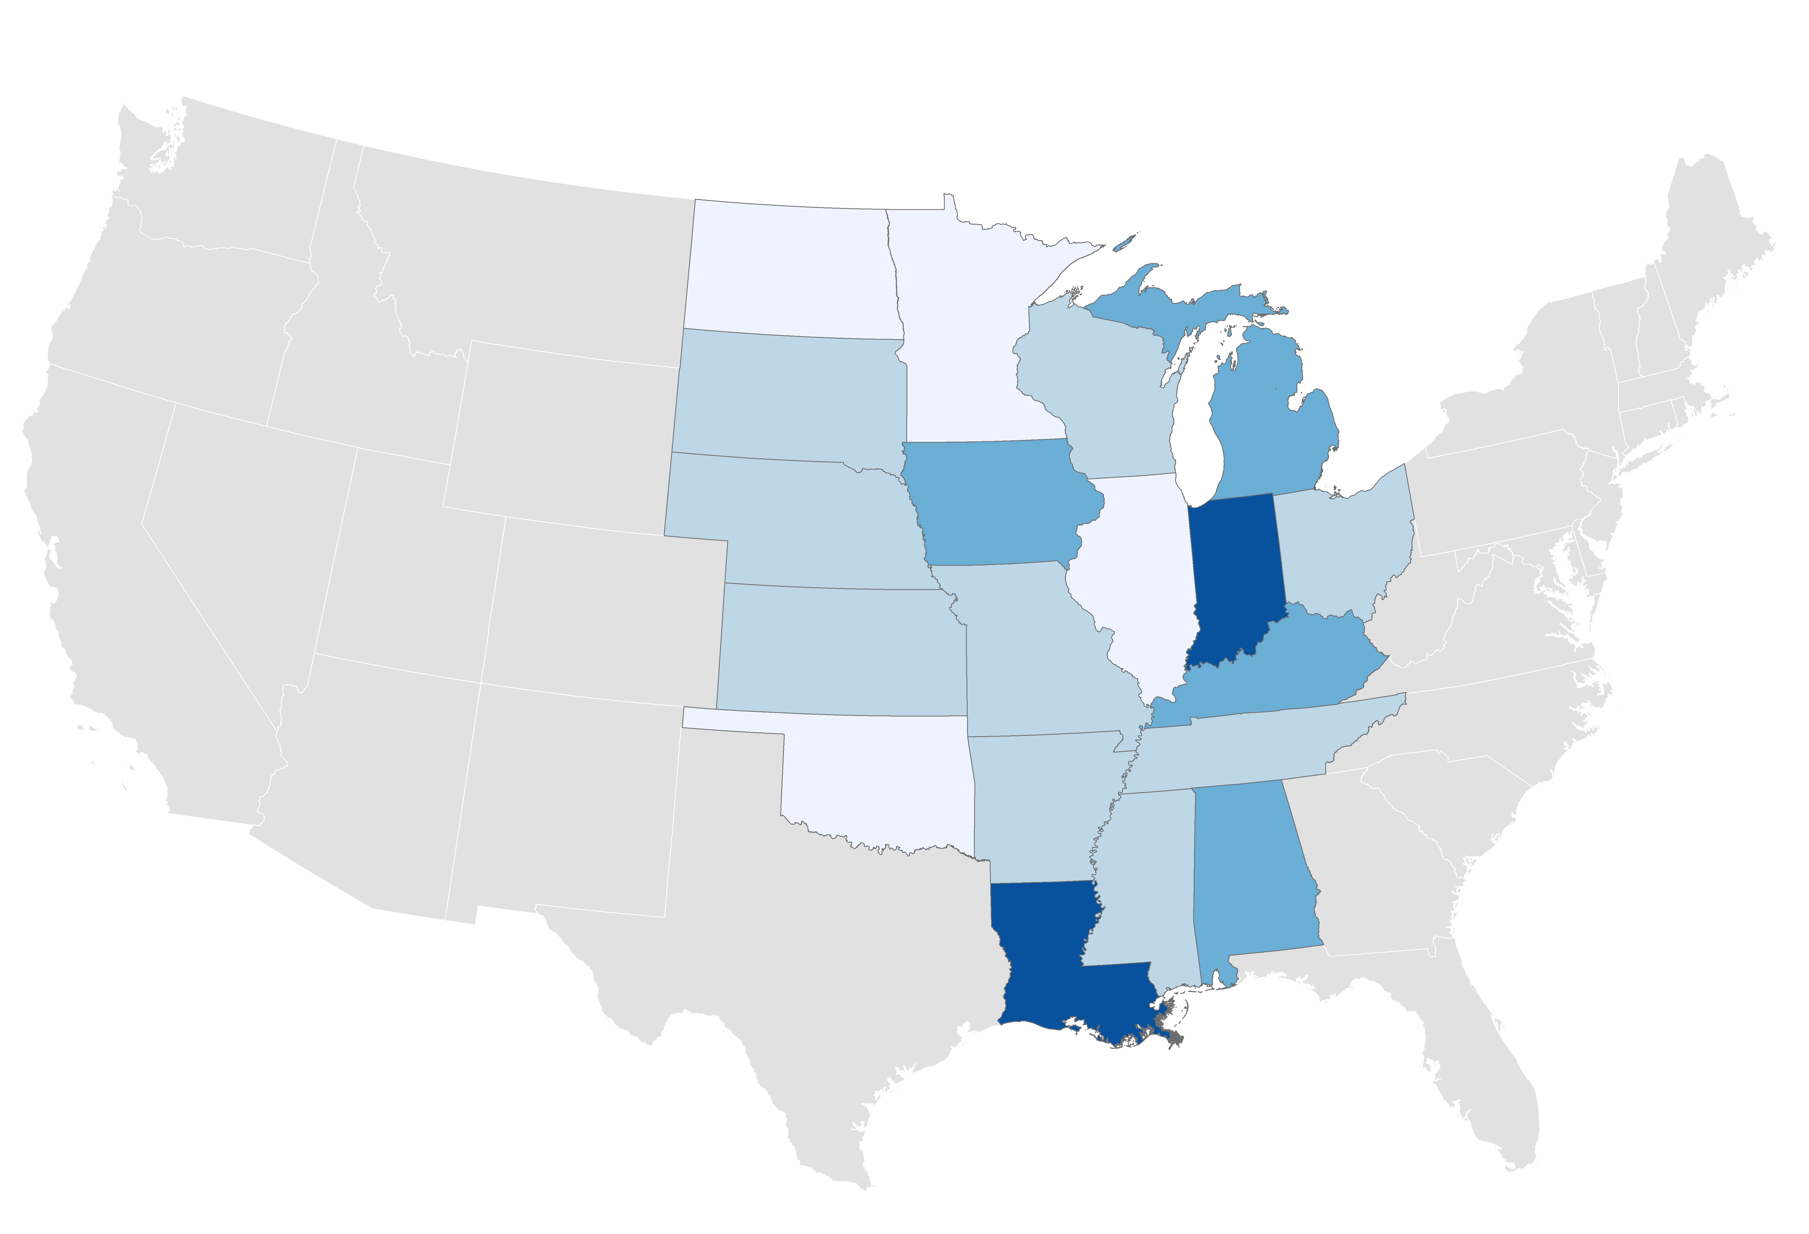
One-third of national exports originate in the Heartland…
Smallest export share:
Oklahoma (9.3%)
Exports’ share of GSP
2017
9.3% — 10.0%
Heartland | 12.3%
Non-Heartland | 9.6%
10.0% — 12.5%
12.5% — 15.0%
15.0% — 17.5%
Greatest export share:
Louisiana (19.3%)
17.5% — 19.3%
Source: Brookings, “Export Monitor 2018,” April 2018

Slide 11
…and it remains the source of most of the country’s agricultural output
Heartland
Top 5 Heartland states by agricultural output account for a quarter of all national production
Non-Heartland
Source: Brookings analysis of USDA data

Slide 12
 | Advanced industries
 | Share of total, 2016 |  | Percent change, 2015-16
 | Employment | Output | Employment | Output
Michigan | 13.3% | 22.2% | 2.8% | 0.4%
Indiana | 12.6% | 24.5% | 0.8% | -1.0%
Alabama | 11.0% | 19.4% | 0.6% | 0.7%
Kansas | 10.7% | 20.0% | 0.8% | -0.1%
Ohio | 9.9% | 16.4% | 0.6% | -0.4%
Kentucky | 9.8% | 17.2% | 2.5% | 1.2%
Minnesota | 9.7% | 16.0% | 4.3% | 1.9%
Wisconsin | 9.4% | 14.1% | -0.2% | -2.4%
Illinois | 9.4% | 16.0% | -0.5% | -3.0%
Tennessee | 9.3% | 13.6% | 3.2% | 1.4%
Missouri | 8.7% | 16.5% | 2.3% | -0.3%
Iowa | 8.7% | 13.8% | -2.8% | -4.2%
Oklahoma | 8.1% | 20.5% | -6.3% | -4.3%
Mississippi | 7.7% | 18.2% | -2.0% | 0.8%
Louisiana | 7.4% | 22.5% | -5.1% | -0.5%
Nebraska | 7.2% | 10.6% | -0.8% | -0.5%
North Dakota | 7.2% | 14.9% | -2.9% | 2.6%
South Dakota | 6.9% | 10.1% | -1.5% | -2.3%
Arkansas | 6.8% | 12.3% | -0.5% | -0.7%
Heartland | 9.8% | 17.4% | 0.6% | -0.7%
Non-Heartland | 9.5% | 17.2% | 1.3% | 0.4%
Advanced industries play an especially important role in the Heartland economy
Michigan and Indiana have the first and second largest advanced sector employment shares in the nation
Source: Brookings analysis of Emsi data

Slide 13
The region is a key contributor to national energy production…
Renewable energy
Heartland
Non-Heartland
16% of Heartland energy production comes from renewable sources, compared with just 9% in Non-Heartland states
Note: Renewables include nuclear energy, biofuels, geothermal and hydroelectric, solar thermal and PV, wind, and biomass
Source: Brookings analysis of EIA-SEDS data

Slide 14
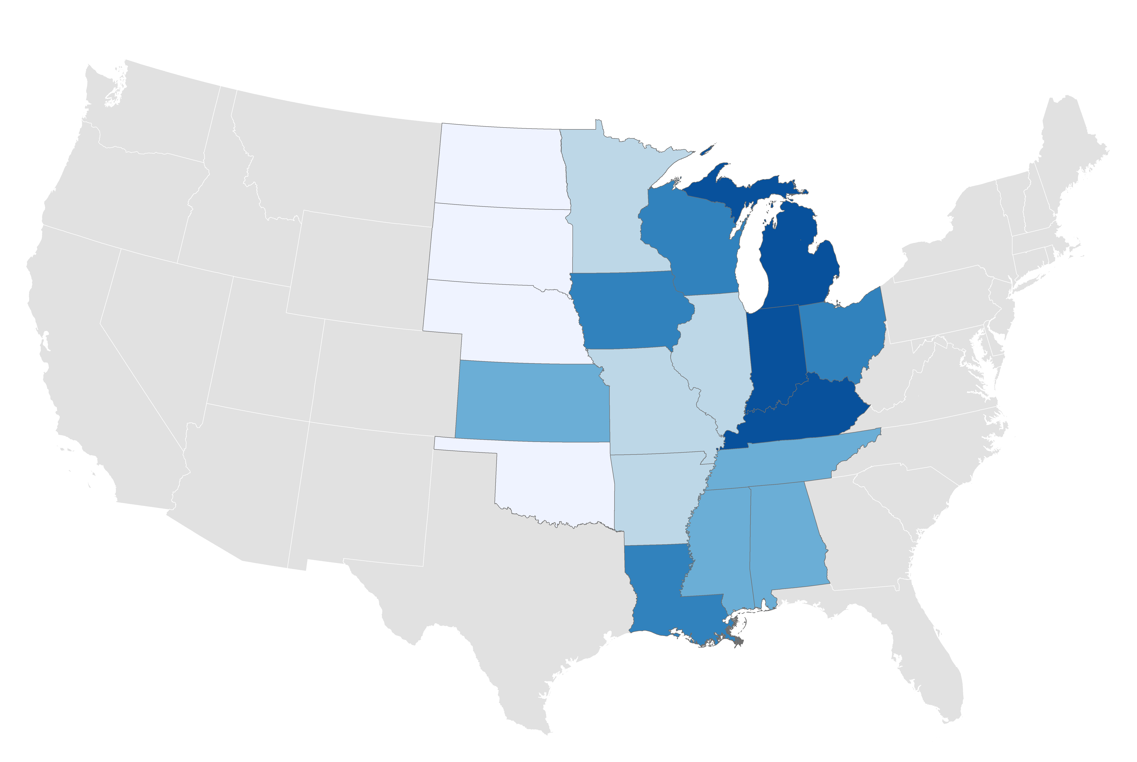
…and is notably specialized in manufacturing industries
Smallest:
North Dakota (7.0%)
Largest:
Indiana (26.5%)
Share of state output
Manufacturing, 2016
7.0% — 12.5%
12.5% — 15.0%
15.0% — 17.5%
17.5% — 20.0%
Heartland | 16.8%
Non-Heartland | 10.0%
20.0% — 26.5%
Source: Brookings analysis of Emsi data

Slide 15
1
What we’re doing
2
Initial indicators
Strengths
Weaknesses
Key measures

Slide 16
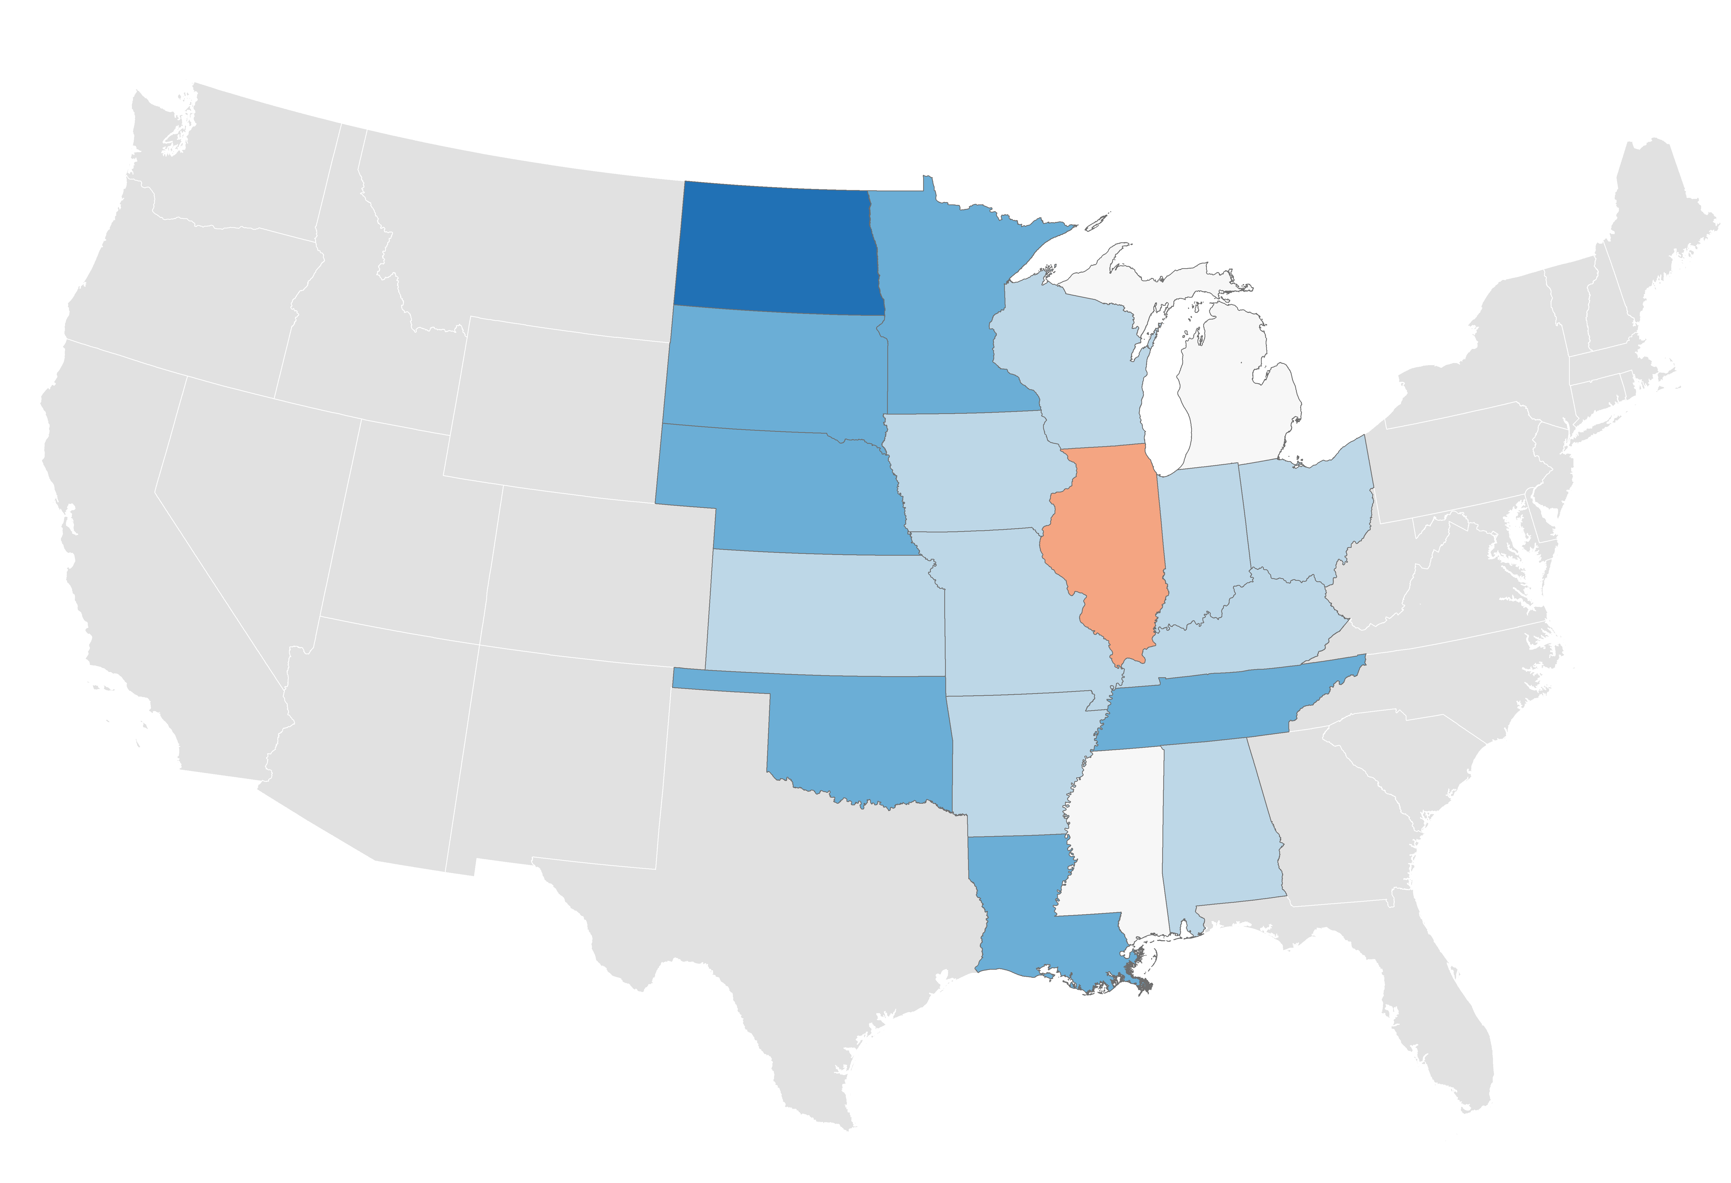
Population growth in the Heartland has been slow…
Fastest:
North Dakota (1.91%)
Slowest:
Illinois (-0.01%)
Total population CAGR
2010 - 2016
-0.01% — 0.00%
0.00% — 0.10%
0.10% — 0.50%
0.50% — 1.00%
Heartland | 0.32%
Non-Heartland | 0.93%
1.00% — 1.91%
Source: “2017 Population Estimates,” U.S. Census Bureau, Population Division

Slide 17
…and job growth has trailed the rest of the country
112.6
103.0
Heartland
Non-Heartland
Source: “Quarterly Census of Employment and Wages,” BLS

Slide 18
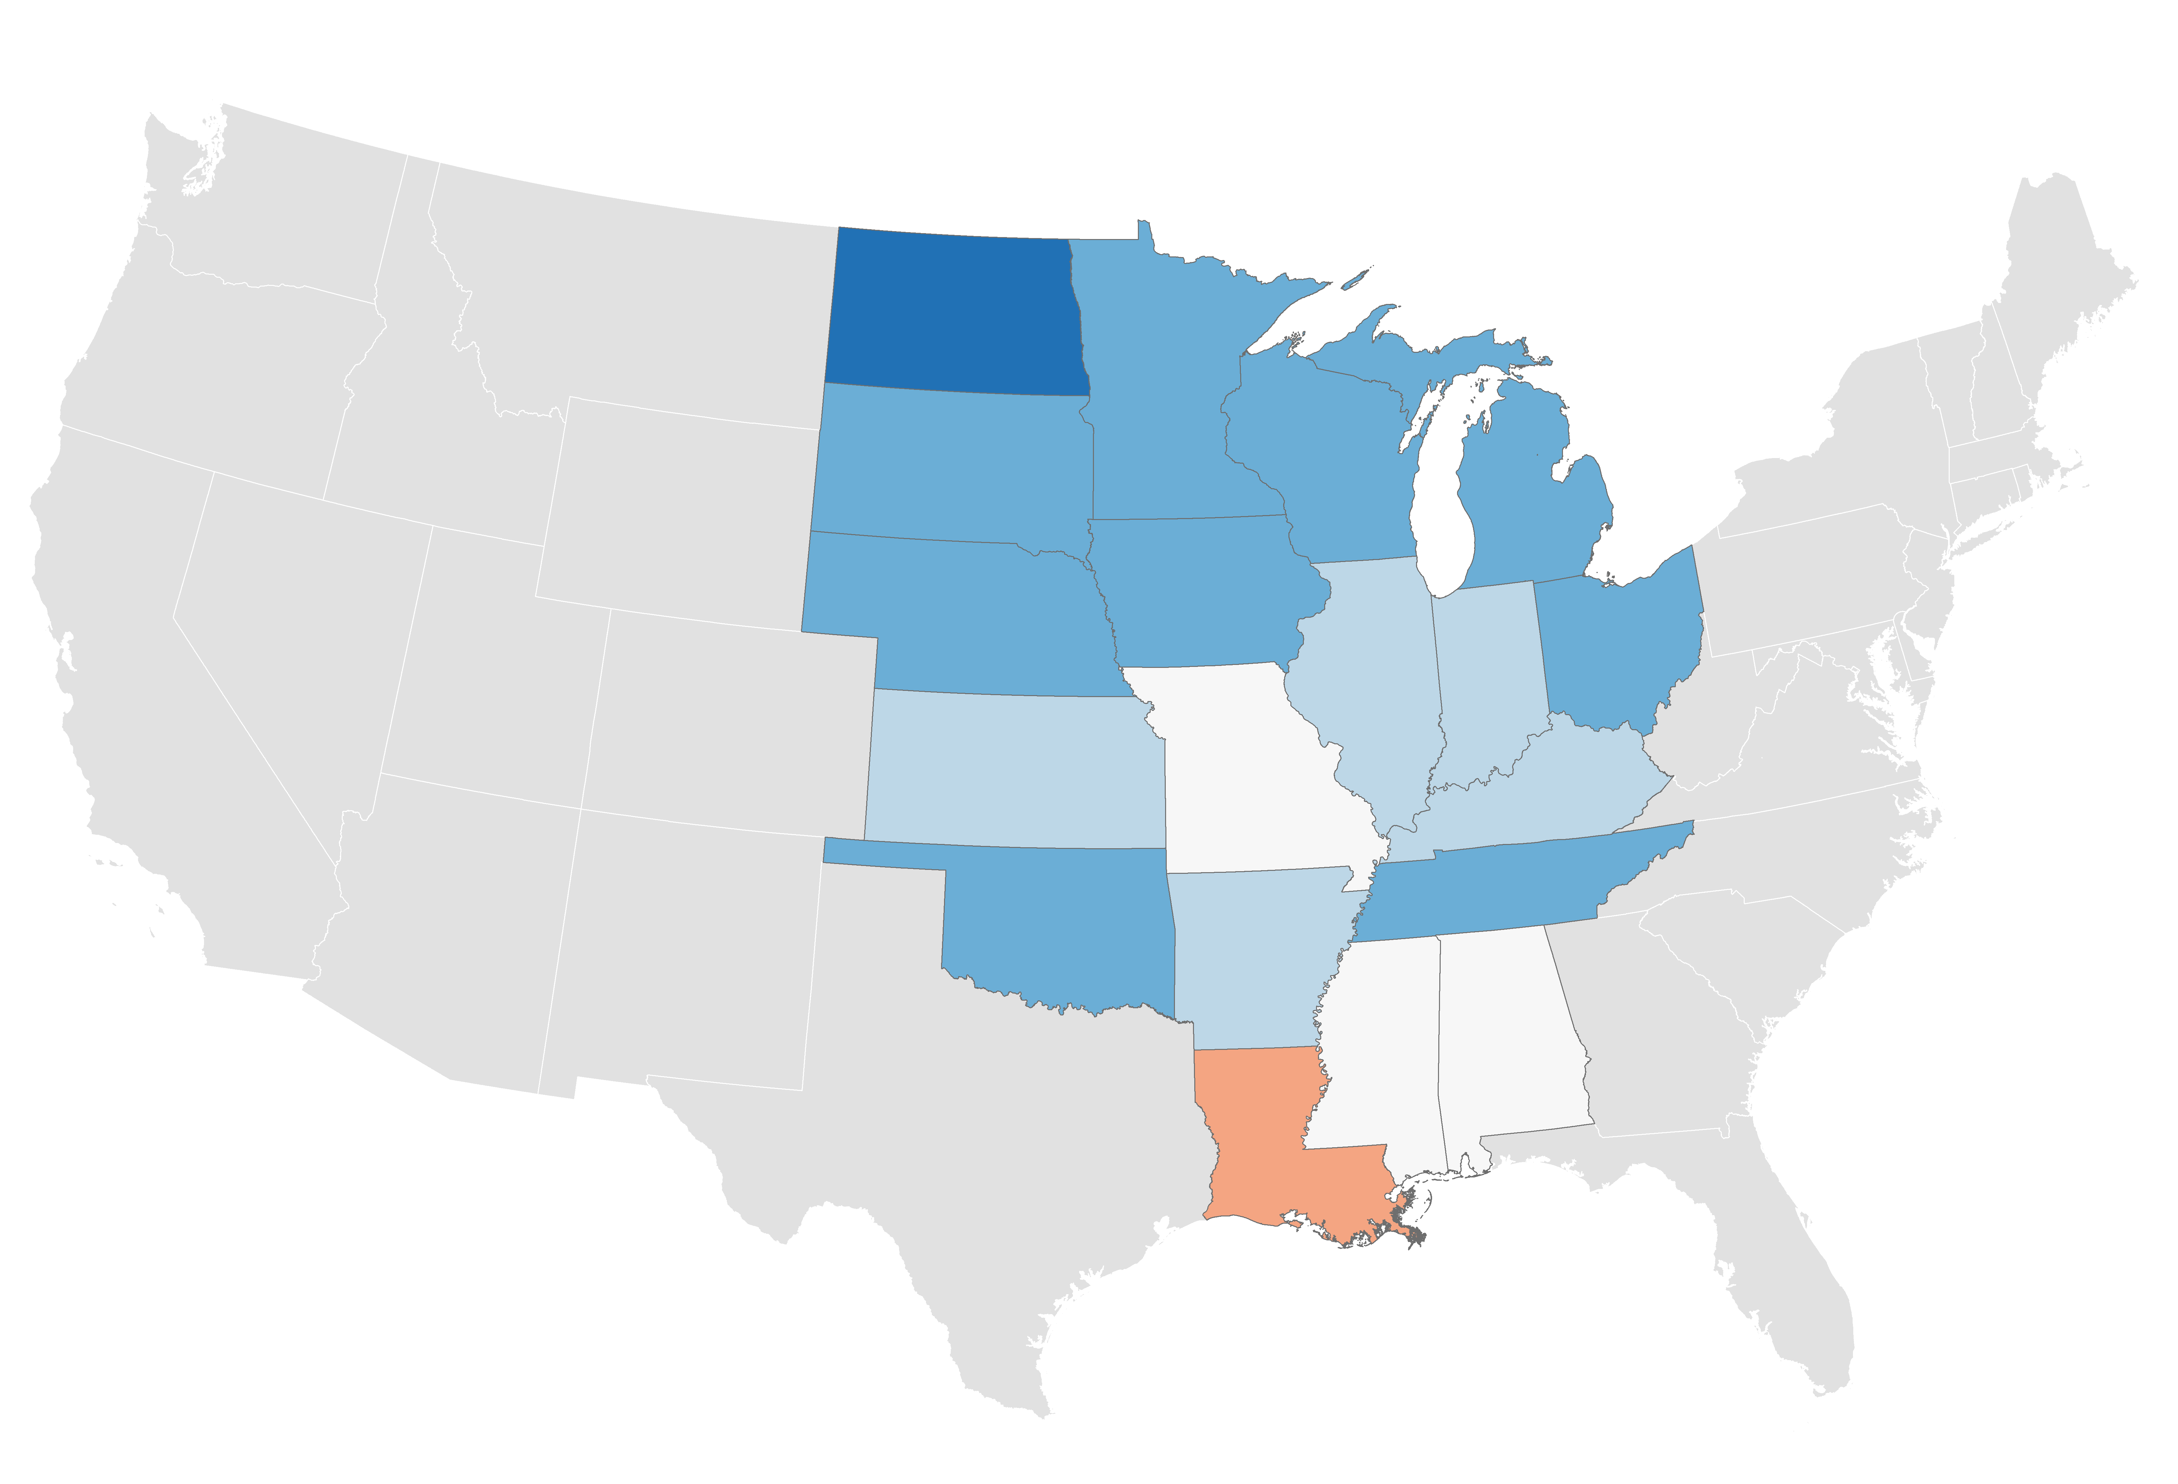
Fastest grower:
North Dakota (5.0%)
In most states, output growth has lagged as well
Real output CAGR
2010 – 2016
-1.1% — 0.0%
Heartland | 1.4%
Non-Heartland | 1.9%
0.0% — 1.0%
1.0% — 1.5%
1.5% — 2.5%
Slowest grower:
Louisiana (-1.1%)
2.5% — 5.0%
Source: Brookings analysis of Emsi and BEA data

Slide 19
 | Advanced services
 | Share of total, 2016 |  | Percent change, 2015-16
 | Employment | Output | Employment | Output
Michigan | 5.6% | 7.0% | 3.2% | 2.6%
Illinois | 5.1% | 6.8% | 1.6% | -0.7%
Kansas | 4.6% | 6.1% | 4.5% | 1.4%
Missouri | 4.5% | 6.8% | 3.5% | 0.6%
Minnesota | 4.5% | 6.1% | 11.1% | 8.9%
Alabama | 4.2% | 5.5% | 1.6% | 0.8%
Nebraska | 3.8% | 4.7% | 1.0% | 3.7%
Ohio | 3.8% | 5.0% | 2.8% | 1.8%
Tennessee | 3.7% | 5.1% | 3.3% | 1.2%
Wisconsin | 3.4% | 5.0% | 3.3% | 2.5%
North Dakota | 3.4% | 4.0% | -2.5% | -0.8%
Louisiana | 3.1% | 3.6% | -2.8% | -3.1%
Kentucky | 3.0% | 3.7% | -2.6% | -1.1%
Oklahoma | 3.0% | 3.7% | -0.1% | 0.1%
Indiana | 3.0% | 3.9% | 2.6% | 1.5%
Arkansas | 2.7% | 3.8% | 3.5% | 1.5%
Iowa | 2.6% | 3.4% | -0.2% | 0.3%
South Dakota | 2.4% | 3.5% | 2.4% | 0.5%
Mississippi | 2.0% | 3.3% | -6.4% | -1.5%
Heartland | 4.0% | 5.3% | 2.6% | 1.4%
Non-Heartland | 5.8% | 8.7% | 2.9% | 2.7%
High-value advanced services have a small presence in the region
81% of advanced services’ output comes from outside the Heartland, and is growing more concentrated
Source: Brookings analysis of Emsi data

Slide 20
Growth has been almost exclusively in metro areas
Total population
2010 – 2017
Large metros
Medium metros
Small metros
Micropolitan areas
Adjacent rural counties
Non-adjacent rural counties
Source: “2017 Population Estimates,” U.S. Census Bureau, Population Division

Slide 21
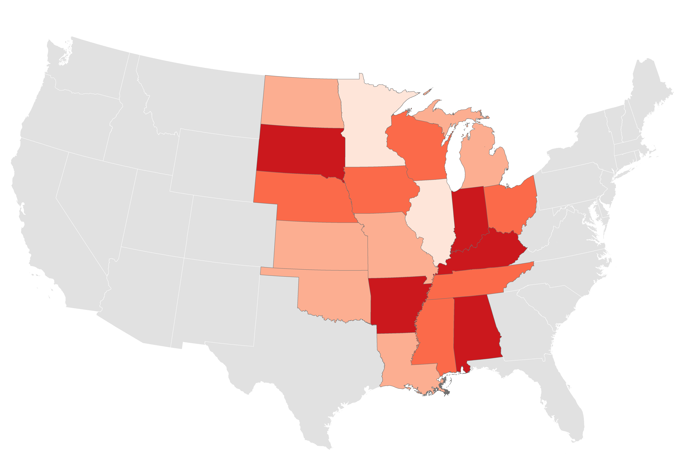
Lowest:
Minnesota (45.0%)
The Heartland is especially exposed to automation
Highest:
Indiana (48.8%)
Avg. automation potential
2016
45.0% — 46.0%
Heartland | 47.1%
Non-Heartland | 45.0%
46.0% — 47.0%
47.0% — 48.0%
48.0% — 48.8%
Note: Automation potential measures the percentage of tasks in a given occupation that could be automated given current technology
Source: Brookings analysis of McKinsey Global Institute data

Slide 22
As it has elsewhere, startup activity has waned over the last several decades
Heartland
Non-Heartland
Note: New firm establishment entries as a share of total establishments
Source: Brookings analysis of U.S. Business Dynamics Statistics

Slide 23
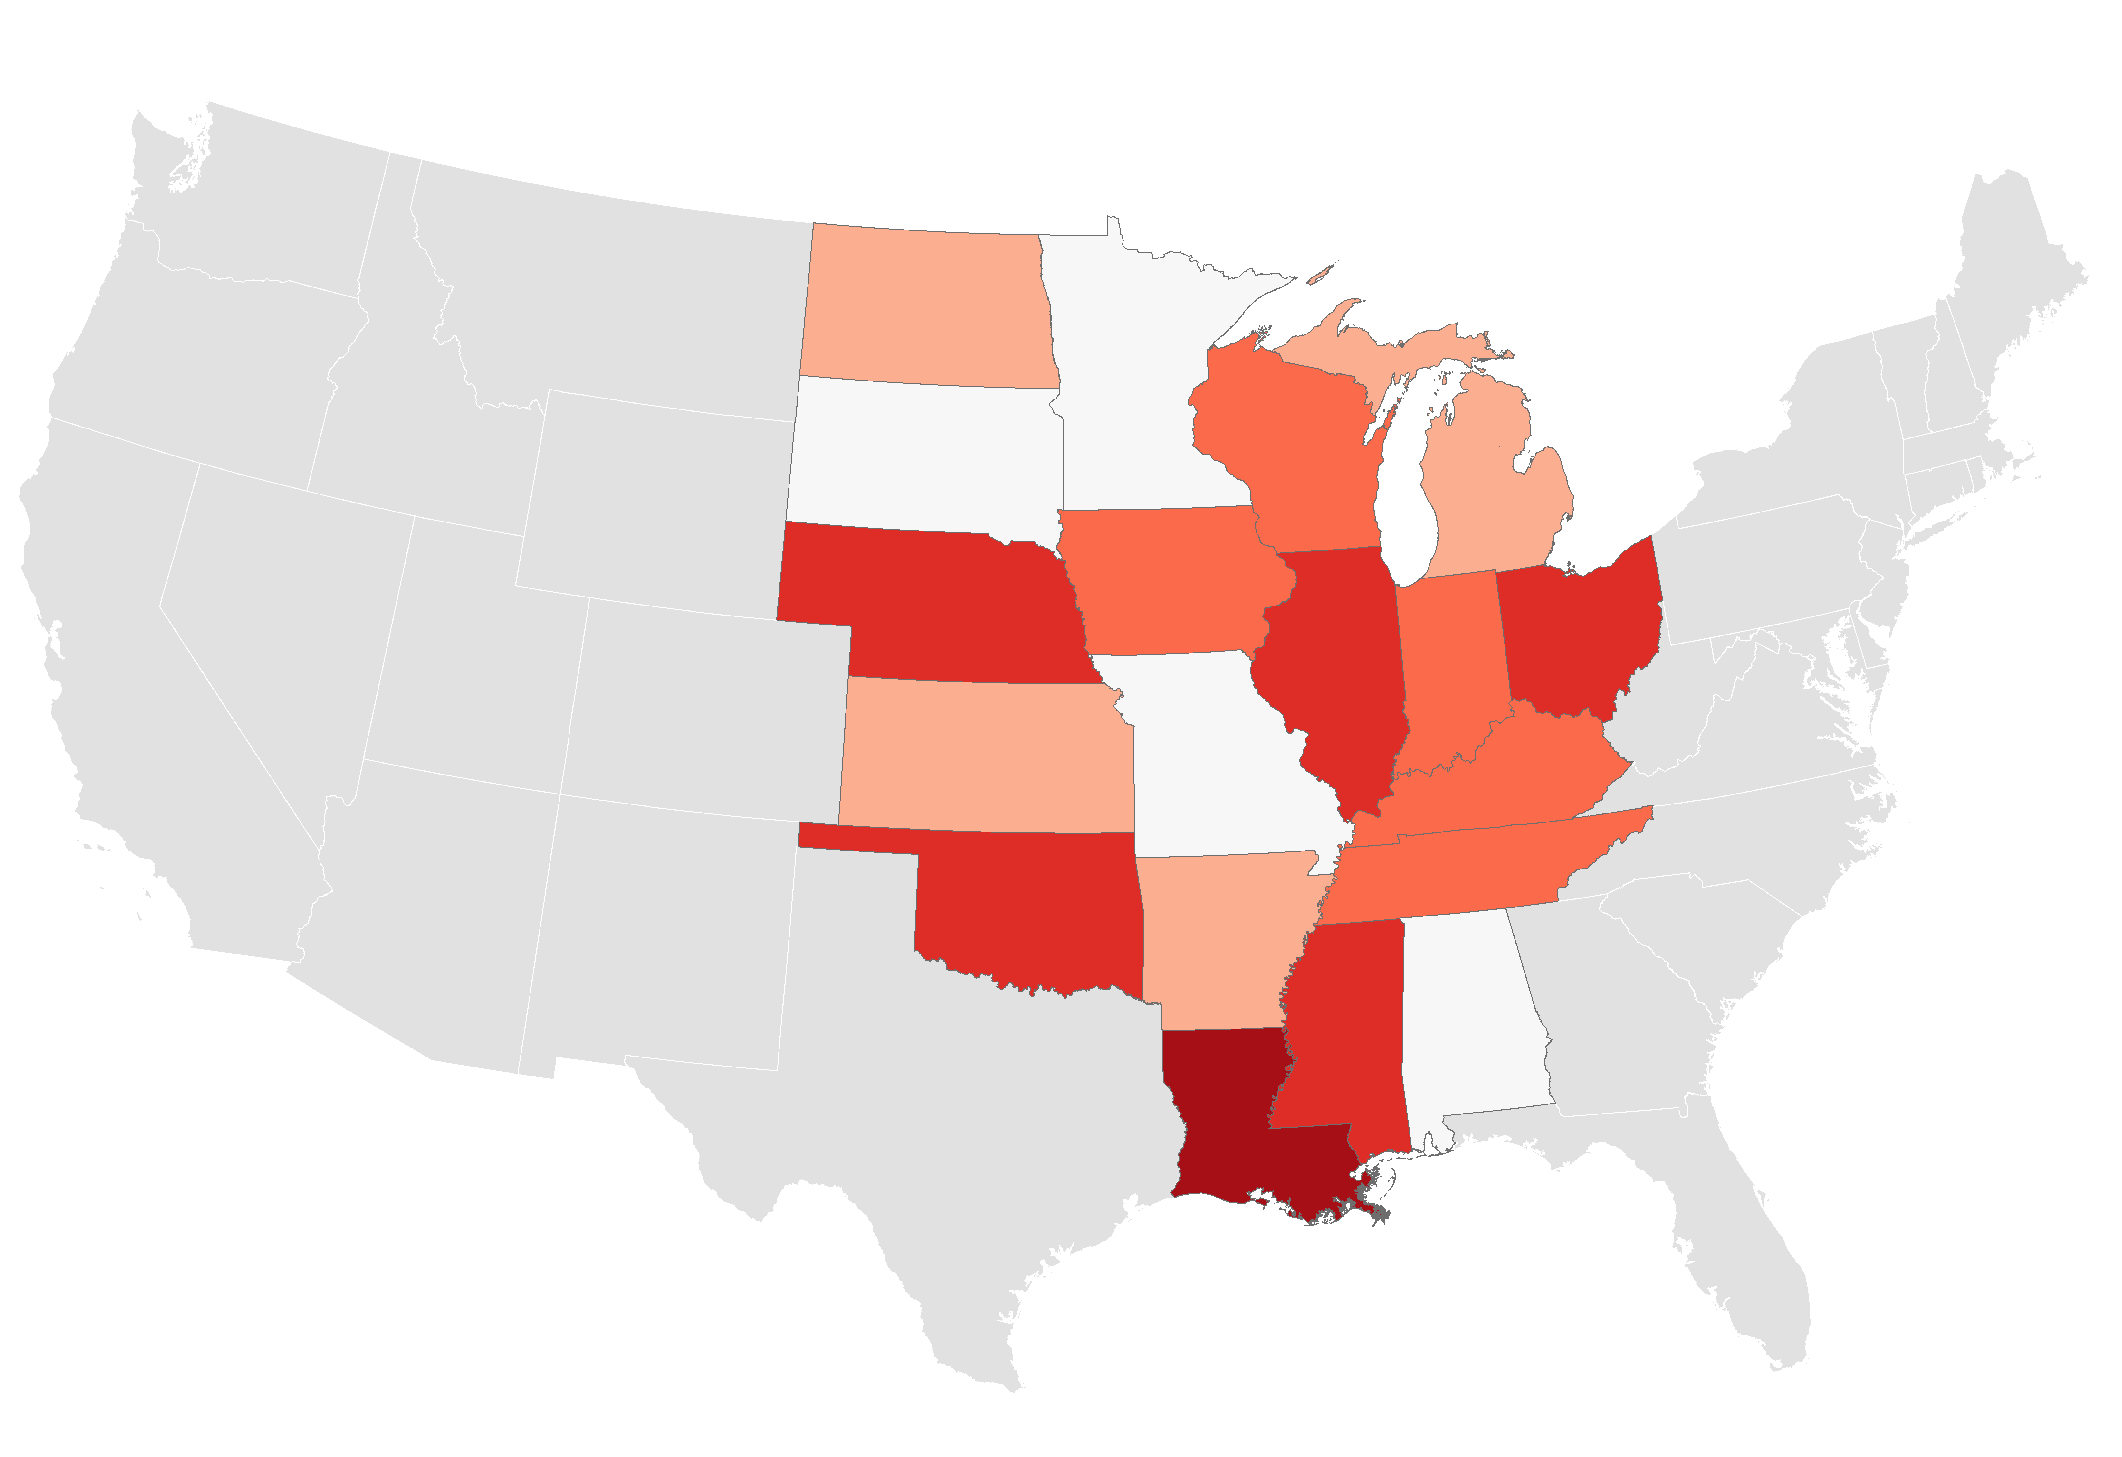
Inequality has been on the rise since the Recession…
Change in 90/10 ratio
2010 – 2016
90/10 ratio | 2016 | 2010-16
Heartland | 10.59 | +0.42
Non-Heartland | 11.67 | +0.58
-0.60 — +0.00
+0.00 — +0.30
Largest decrease:
Alabama (-0.60)
+0.30 — +0.80
+0.80 — +1.20
Largest increase:
Louisiana (+1.78)
+1.20 — +1.78
Note: 90/10 ratio is the ratio of the top decile by household income to the bottom decile
Source: Brookings analysis of version 1.3 of CEPR’s ACS uniform extracts

Slide 24
…and racial income disparities remain stark
Heartland
Non-Heartland
Incomes in black households are less than two-thirds those of white households in the Heartland
Source: Brookings analysis of version 1.3 of CEPR’s ACS uniform extracts

Slide 25
1
What we’re doing
2
Initial indicators
Strengths
Weaknesses
Key measures

Slide 26
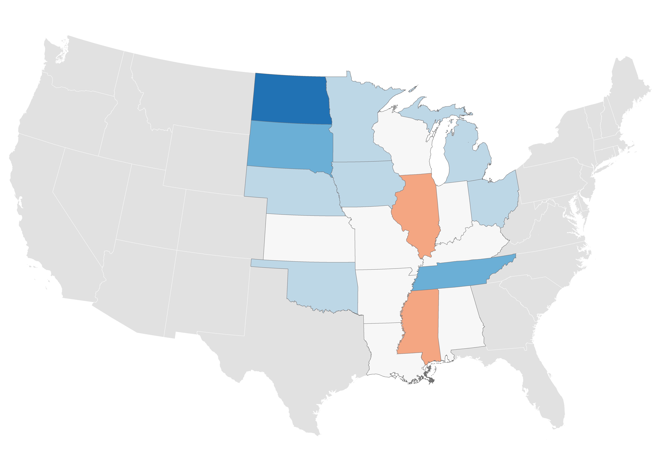
Fastest:
North Dakota (3.8%)
Slowest:
Illinois (-0.3%)
The Heartland has struggled to retain young people…
Millennial population CAGR
2010 – 2016
-0.3% — 0.0%
Heartland | 0.4%
Non-Heartland | 1.2%
0.0% — 0.5%
0.5% — 1.0%
1.0% — 2.0%
2.0% — 3.8%
Note: Millennials defined as residents 18-34 years old
Source: Brookings analysis of ACS data

Slide 27
…and must do more to boost educational attainment
Non-Heartland 2016 average (32.6%)
2016
2010
Source: Brookings analysis of 2016 ACS 1-Year estimates

Slide 28
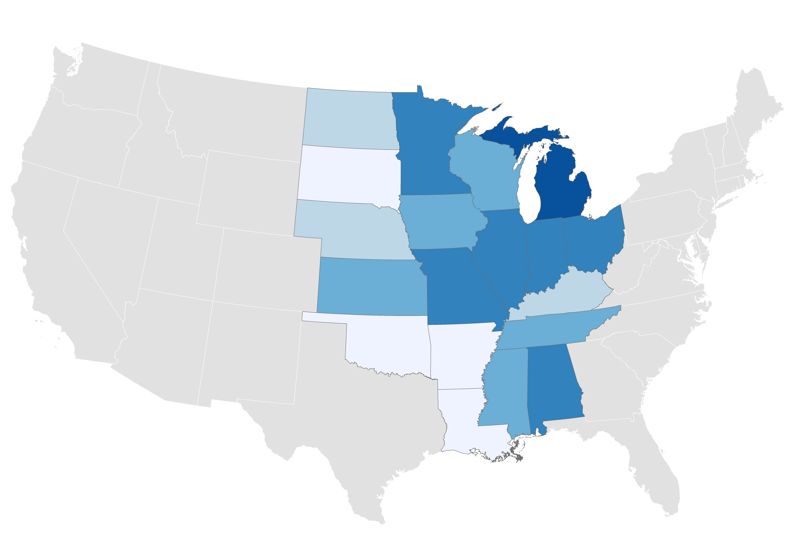
Largest:
Michigan (4.4%)
R&D spending should be a priority for Heartland states
Share of state output
R&D, 2015
0.5% — 0.6%
Heartland | 2.0%
Non-Heartland | 2.7%
0.6% — 1.0%
1.0% — 2.0%
2.0% — 3.0%
Smallest:
Louisiana (0.5%)
3.0% — 4.4%
Source: Brookings analysis of NSF data

Slide 29
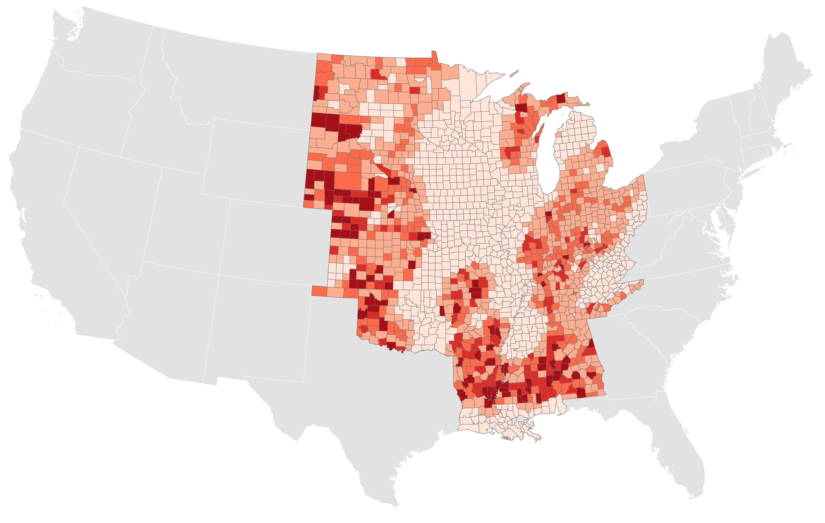
Too many residents still lack access to high-speed broadband
Share of population with no high-speed provider
2016
Heartland | 6.6%
Non-Heartland | 3.4%
0.0% — 1.0%
1.0% — 25.0%
17.2% of Mississippi residents are without high-speed broadband
25.0% — 50.0%
50.0% — 75.0%
75.0% — 100.0%
Source: Brookings analysis of FCC data
Note: High-speed broadband defined as at least 25Mbps for downloads and 3Mbps for uploads

